Slide 1
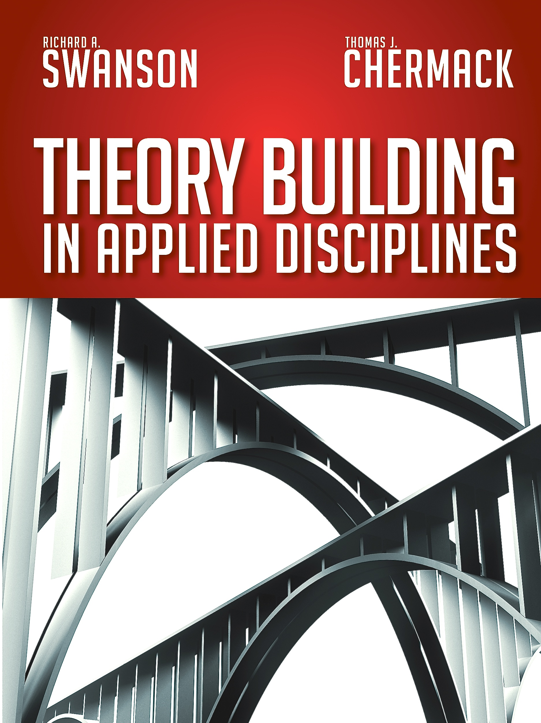
CHAPTER 7
Apply Phase

Slide 2
Chapter 7 – Apply Phase
Chapter Outline
What is application?
Inputs to application
Approaches to applying theories
The Apply Phase of Theory Building
Outputs of the Apply Phase
Quality Indicators for the Apply Phase
Conclusion

Slide 3
What is Application?
The application of the theory to the problem, phenomenon or issue
in the world of practice

Slide 4
Inputs to Application
A set of concepts
Relationships specified
Measurement and outcome criteria specified
Tested – some evidence to support

Slide 5
Approaches to Application
Quantitative – Based on quantifying, counting, and the use of statistical analysis.
Qualitative – Based on the qualities, nature, and the use of intuition and interpretation.
Mixed Methods – Deploys a combination of both quantitative and qualitative approaches.

Slide 6
The Apply Phase of Theory Building

Slide 7
Outputs of the Apply Phase of
Theory Building
Procedures for applying the theory in the future
Solved problems!

Slide 8
Quality Indicators for the
Apply Phase
Fruitfulness – Are problems consistently solved using the theory, and are there clear benefits?

Slide 9
Conclusion
The Apply Phase bring the theory into the real world and uses it to solve problems. The goal is to develop procedures by which the theory can be applied again, and gains utility in consistently solving similar problems.

