Slide 1
CHAPTER 4
Conceptualize Phase

Slide 2
Chapter 4 – Conceptualize Phase
Chapter Outline
Introduction
What is the Conceptualize Phase?
Inputs to Conceptual Development
Processes for Conceptual Development
Tools for Conceptualizing
• The Conceptualize Phase
Outputs of the Conceptualize Phase
Quality Indicators for the Conceptualize Phase
Conclusions

Slide 3
Introduction

Slide 4
What is Conceptualize Development?
The specification of the key elements of the theory, with their relationships specified and described, and the domain of application.

Slide 5
Inputs to Conceptualize Development
Practical Problems
Incomplete Existing Theories
New Areas of Human Activity

Slide 6
Processes for Conceptual Development
• Dubin’s Approach
• Whetten’s Approach
• Weick’s Approach
• Storberg-Walker’s Approach

Slide 7
Processes for Conceptual Development

Slide 8
Specific Theorizing Tools

Slide 9
Specific Theorizing Tools (continued)

Slide 10
The Conceptualize Phase – Summary of the Steps!

Slide 11
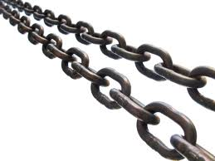
Outputs of The Conceptualize Phase
A set of linked concepts that explains a realm of human activity.

Slide 12
Quality Indicators for the Conceptualize Phase
Parsimony
Rigor and Exactness
Logical Consistency
Generalizability
Empirical Testing

Slide 13
Conclusion
Many processes and tools exist for getting started in theory building. The key is to be thoughtful from the start about the purpose of the
theory and where it is
intended to be applied.

