Slide 1
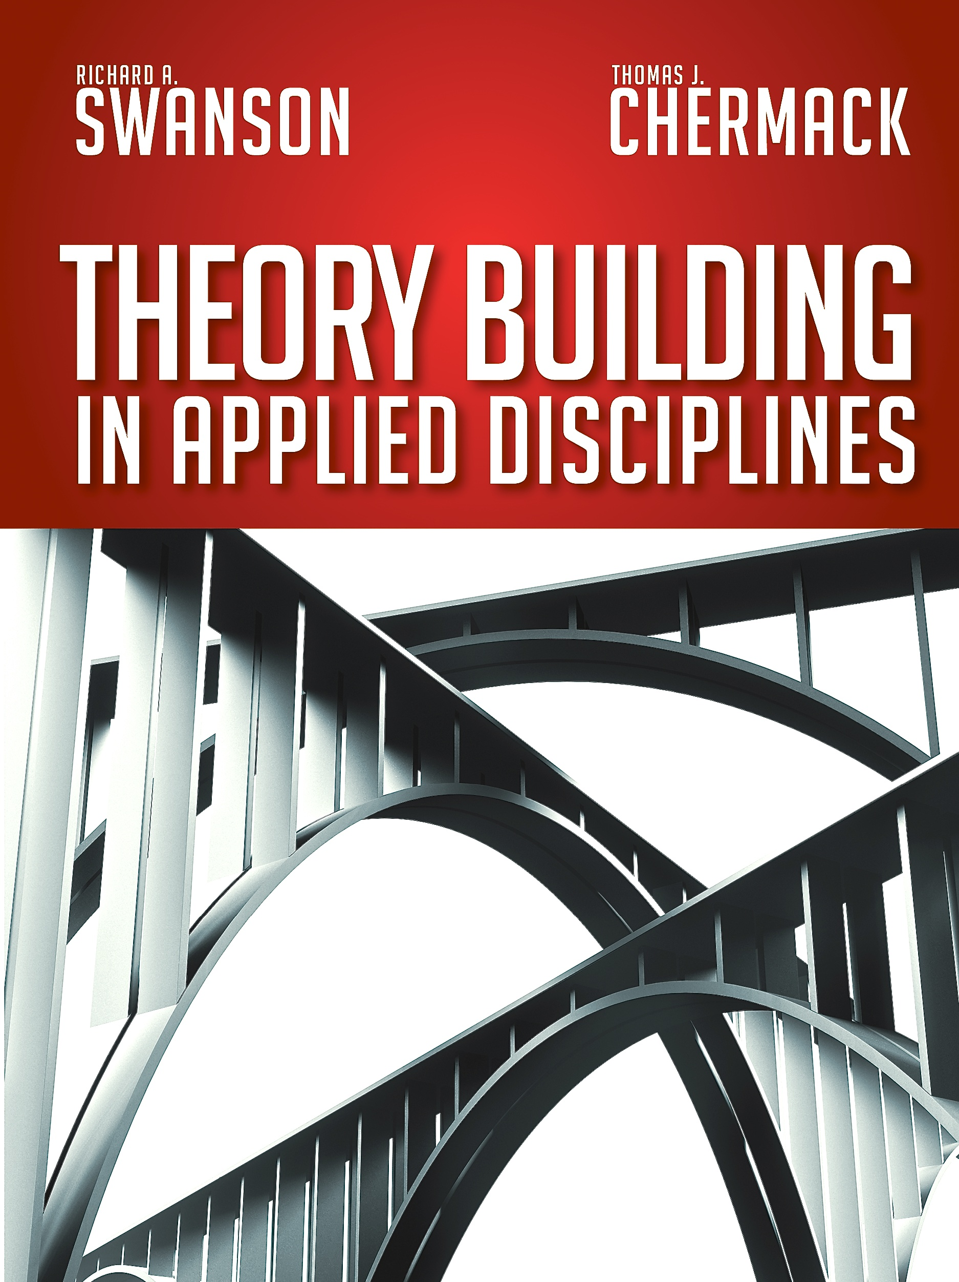
CHAPTER 2
Foundations
and
Definitions of Theory Building

Slide 2
Chapter 2 – Foundations and Definitions of Theory Building
Chapter Outline
Introduction
Definitions of Theory
Research Paradigms in Theory Building
Types of Theories
Existing Work on Theory Building
A Theory Framework
General Criteria for Assessing Theories
Conclusions

Slide 3
Definitions of Theory
A set of linked concepts with relationships specified and described:
• A theory describes a specific realm of knowledge and explains how it works.
• Applied disciplines are realms of study and practice that are fully understood through their use in the functioning world.
• Theories Versus Models
• Positivism
• Interpretivism
• Critical Science

Slide 4
Philosophical Orientations for Theory Building

Slide 5
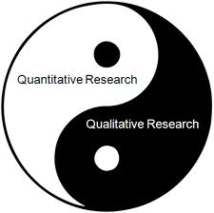
Research Paradigms in
Theory Building
• Quantitative
• Qualitative
• Mixed Methods

Slide 6
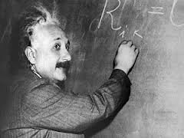
Types of Theories
• Grand Theories
• Midrange Theories
• Local Theories
• Theory Type
Connections

Slide 7
Existing Work on
Theory Building
• MANAGEMENT
• HUMAN RESOURCE DEVELOPMENT
• SOCIOLOGY
• NURSING
• EDUCATION
• COMMUNICATION
• LEADERSHIP
• PUBLIC POLICY
• ARCHITECTURE
• ETC.

Slide 8
A Theory Framework

Slide 9
General Criteria for Assessing Theories
Importance
Preciseness & Clarity
Parsimony & Simplicity
Comprehensiveness
Operationality
Empirical Validity or Verifiability
Fruitfulness
Practicality

Slide 10
Conclusion
A summary of the Foundational and Definitional Differences in Theory Building

